Slide 1

Zomato Analysis
Presentation

Slide 2

Meet the Team
Mohammad Azeemuddin
Mr. Shivam Pandey
Mr. Arjun Mada
Mr. Ammar Khalilur Rehman Shaikh
Mr. Yogendra Singh Mehra
Mr. Prakash Kumar
Mr. Koka Siddhartha
Mohammad Azeemuddin
Mr. Shivam Pandey
Mr. Arjun Mada
Mr. Ammar Khalilur Rehman Shaikh
Mr. Yogendra Singh Mehra
Mr. Prakash Kumar
Mr. Koka Siddhartha

Slide 3
KPI’s of the Project
1. Build a Data Model using the Sheets in the Excel File
2. Build a Calendar Table using the Columns Datekey_Opening I. Financial Quarter ( Quarters based on Financial Month FQ-1 . FQ-2..)
3. Convert the Average cost for 2 column into USD dollars (currently the Average cost for 2 in local currencies
4.Find the Numbers of Resturants based on City and Country.
5.Numbers of Resturants opening based on Year , Quarter , Month
6. Count of Resturants based on Average Ratings
7. Create buckets based on Average Price of reasonable size and find out how many resturants falls in each buckets
8.Percentage of Resturants based on "Has_Table_booking"
9.Percentage of Resturants based on "Has_Online_delivery"
10. Develop Charts based on Cusines, City, Ratings ( Candidate have to think about new KPI to analyse)
11. Build a Dashboard for the KPI's Above.

Slide 4
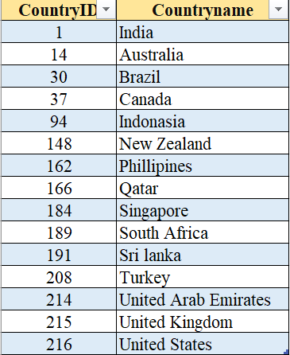
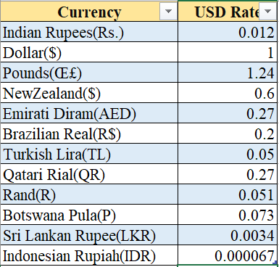
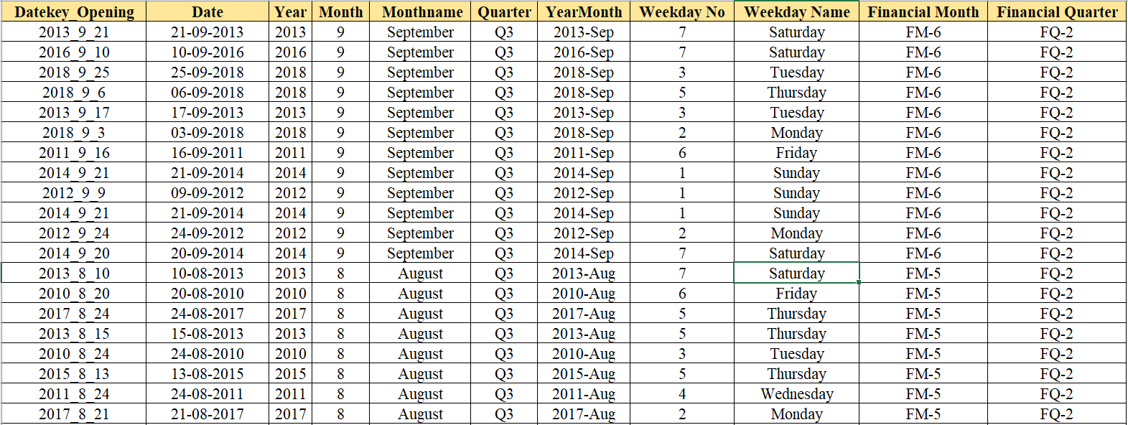
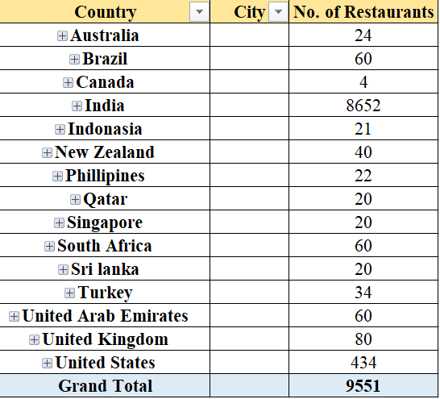
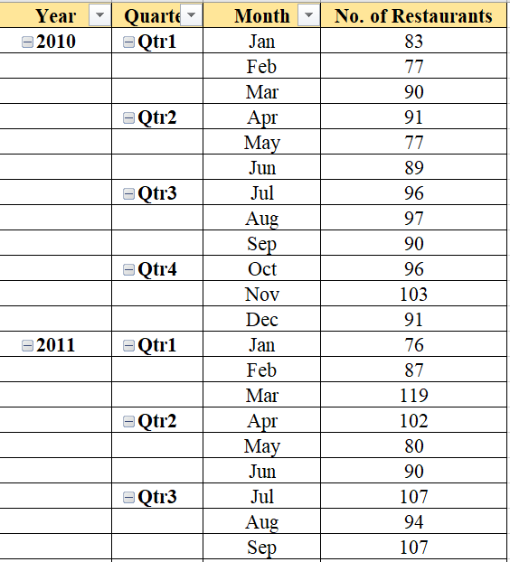
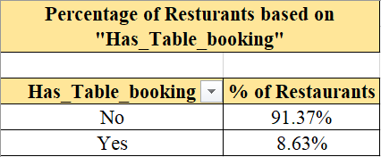
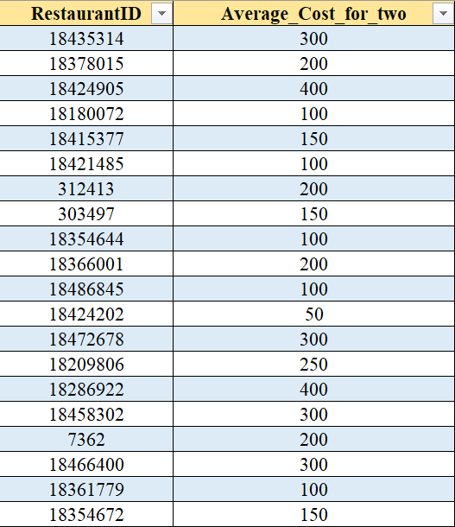
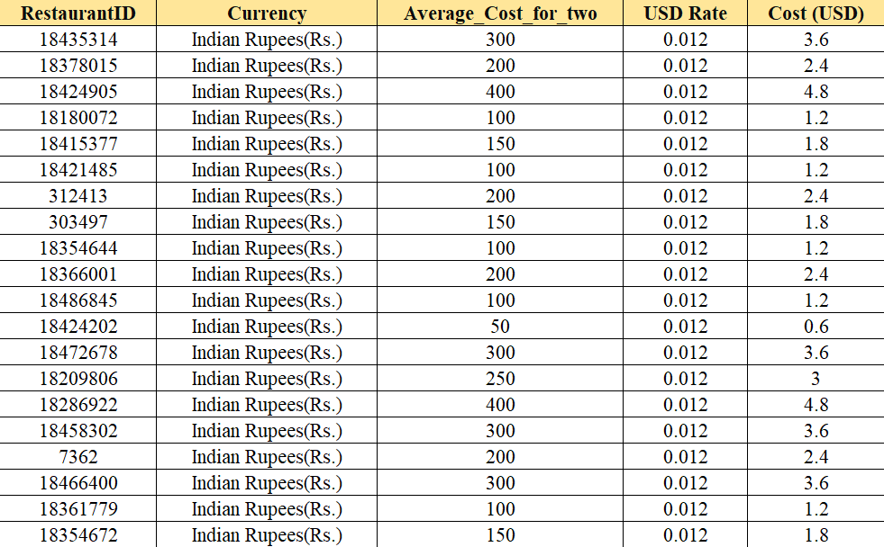
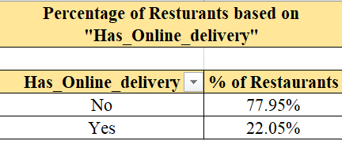
Data Model used in the Project

Slide 5
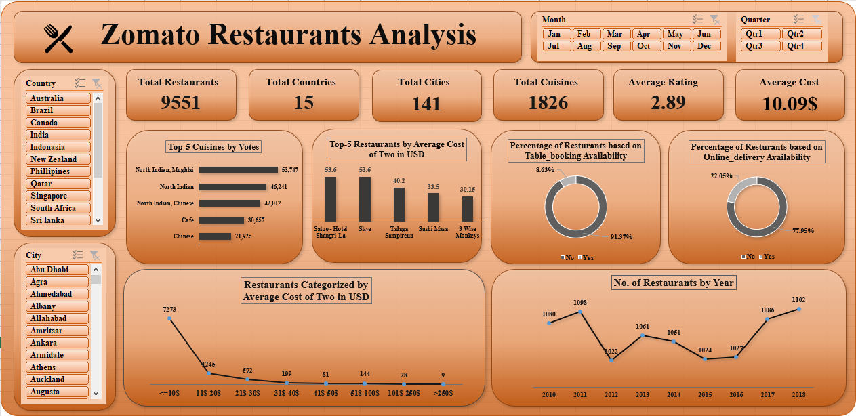
Excel Dashboard

Slide 6
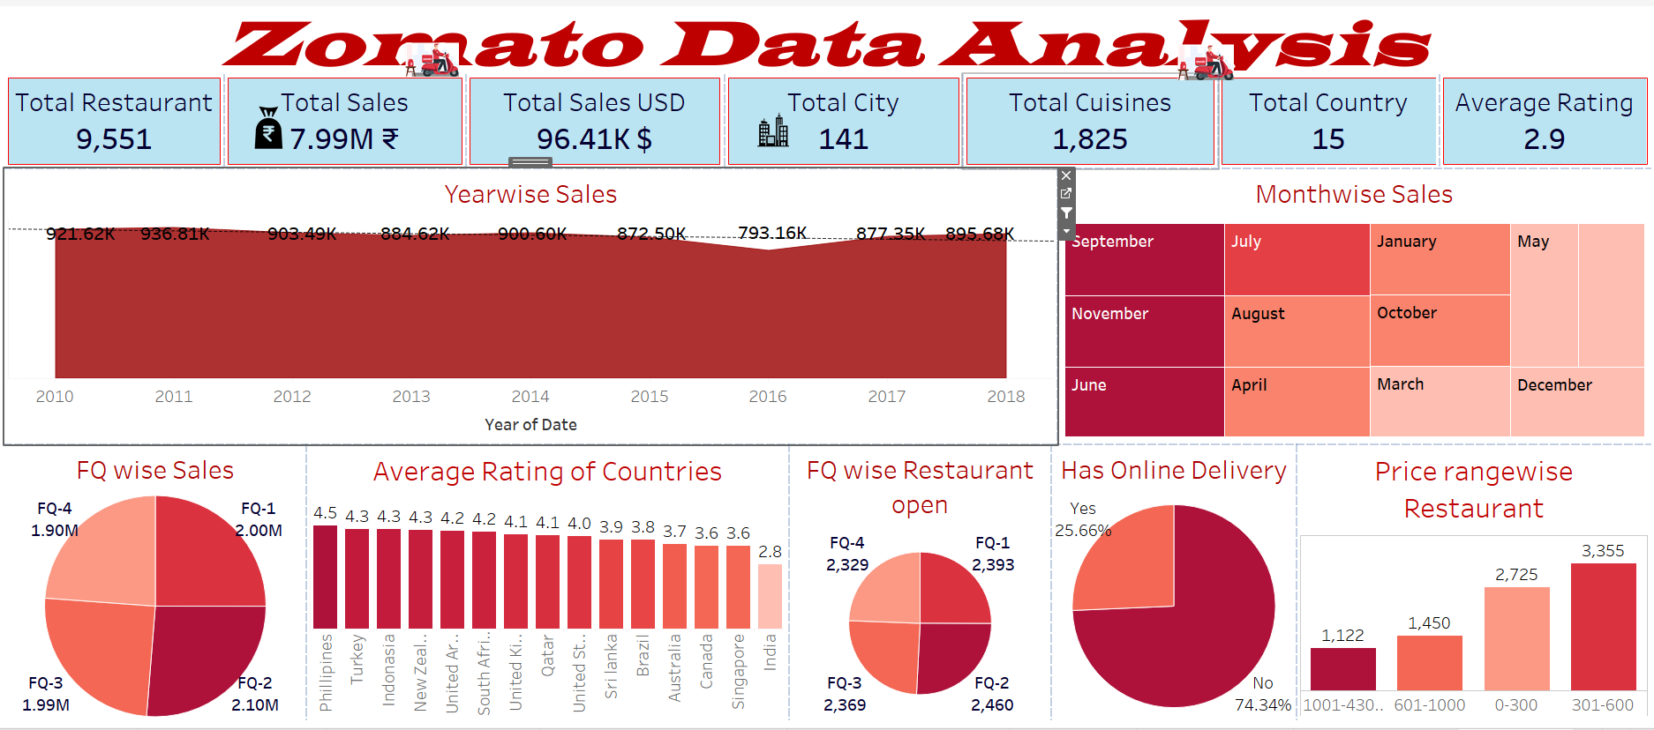
Tableau Dashboard

Slide 7
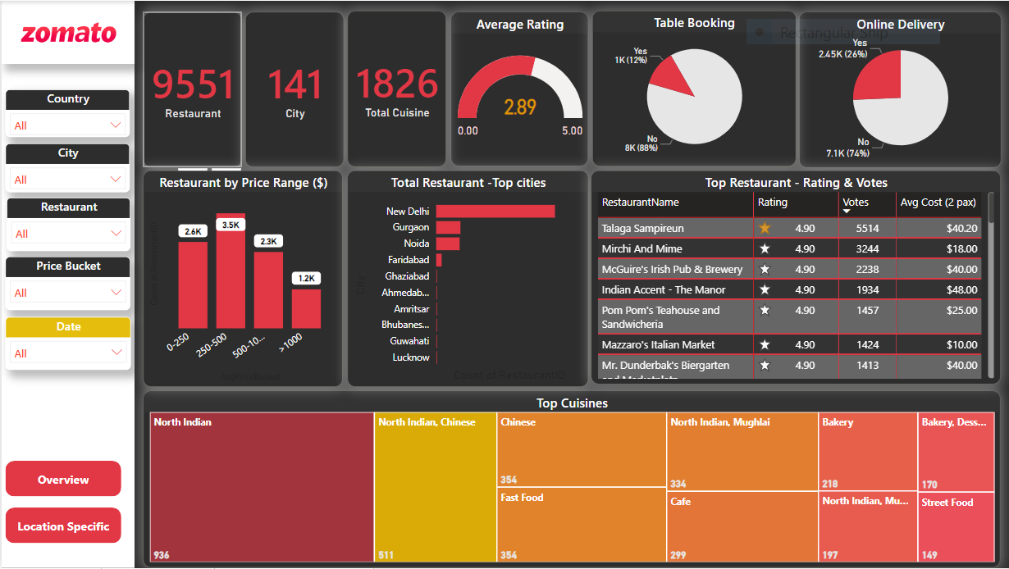
Power BI Dashboard

Slide 8
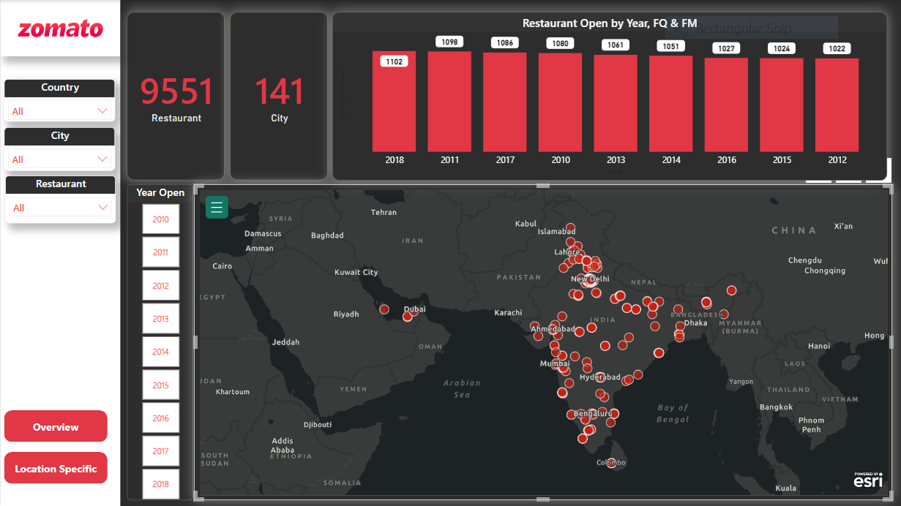
Power BI Dashboard (Country wise)

Slide 9
Key Accomplishments
Conducted comprehensive data analysis on Zomato's vast dataset, extracting meaningful insights and trends that contributed to informed decision-making.
Leveraged tools and algorithms to identify patterns, preferences, and customer behaviour, enabling targeted marketing campaigns and personalized recommendations.
Developed interactive dashboards and visualizations using advanced tools such as Tableau, Power BI, or Excel libraries, enabling stakeholders to easily interpret complex data and make data-driven decisions.
Collaborated with cross-functional teams, including product managers, marketing professionals, and business strategists, to align data insights with organizational goals and drive actionable results.
Effectively communicated complex findings and recommendations to both technical and non-technical stakeholders through reports, presentations, and visualizations, facilitating understanding and driving consensus.

Slide 10
Key Insights from Project
We recently completed an in-depth analysis spotlighting Zomato, a trailblazing force in the food-tech domain. This project explored the intricacies of Zomato's operations, market strategies, and technological innovations reshaping the food delivery and restaurant discovery landscape.
Key Areas Explored
Market Insights: Unveiling Zomato's market presence both locally and globally, examining its competitive edge and strategies that drive its expansion in an ever-evolving industry.
Revenue Dynamics: Delving into the diverse revenue streams powering Zomato, from partnerships with eateries to delivery charges and advertising models, revealing the financial backbone of the platform.
Technology & Operations: Examining the technological infrastructure and operational efficiencies that underpin Zomato's success, including a deep dive into its user interface and logistics for seamless food delivery.
Data-Driven Strategies: Analyzing the pivotal role of data analytics in shaping Zomato's decisions, understanding user behaviors, dining trends, and their influence on the platform's strategies.
Social Impact & Sustainability: Evaluating Zomato's initiatives toward social responsibility and sustainability, assessing their impact on local communities and the environment.
Insights & Findings:
This analysis not only shed light on Zomato's operational intricacies but also provided insights into the dynamic landscape of the food-tech industry. Understanding these facets unveils the potential for growth and innovation within the sector.

Slide 11
Challenges and Solution faced during the Project
Data Quality Issues:
Challenge: Ensuring the quality and accuracy of the data being analysed is crucial. Incomplete, inconsistent, or erroneous data can lead to misleading insights.
Solution: Implement robust data cleaning and preprocessing techniques. Identify and remove anomalies, duplicates, and outliers from the dataset1.
Data Visualization Challenges:
Challenge: Presenting complex data in a clear and meaningful way can be tricky.
Solution: Learn effective data visualization techniques. Use charts, graphs, and dashboards to convey insights visually. Keep it simple and relevant.
Gathering the team Challenge: Some people in the group was missing in the project due to which our Tableau presentation was up to mark how we expected as a team. Solution: We sat with the team who where available and decided our further roadmap and how we are going to utilize our skills to make our project successful for us

Slide 12


